Slide 1

DS 6306 FLS 2
Hayoung Cheon

Slide 2
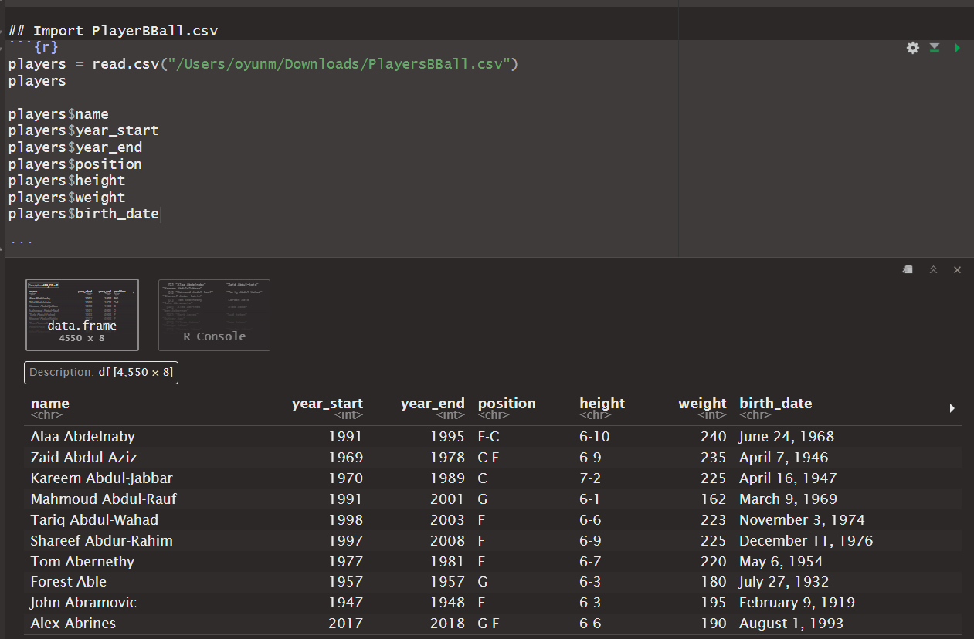
Import basketball player’s csv data

Slide 3
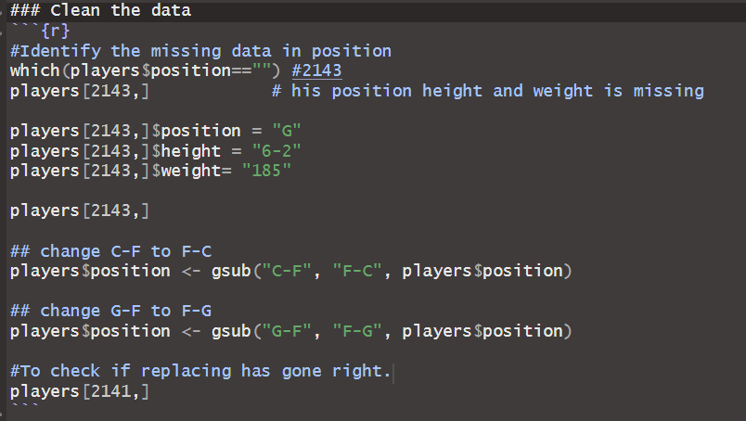
Cleaning some data
I searched google for recognizing
Missing data and entering the right data.
I learned gsub() function from chatGPT which helps replace data easily.

Slide 4
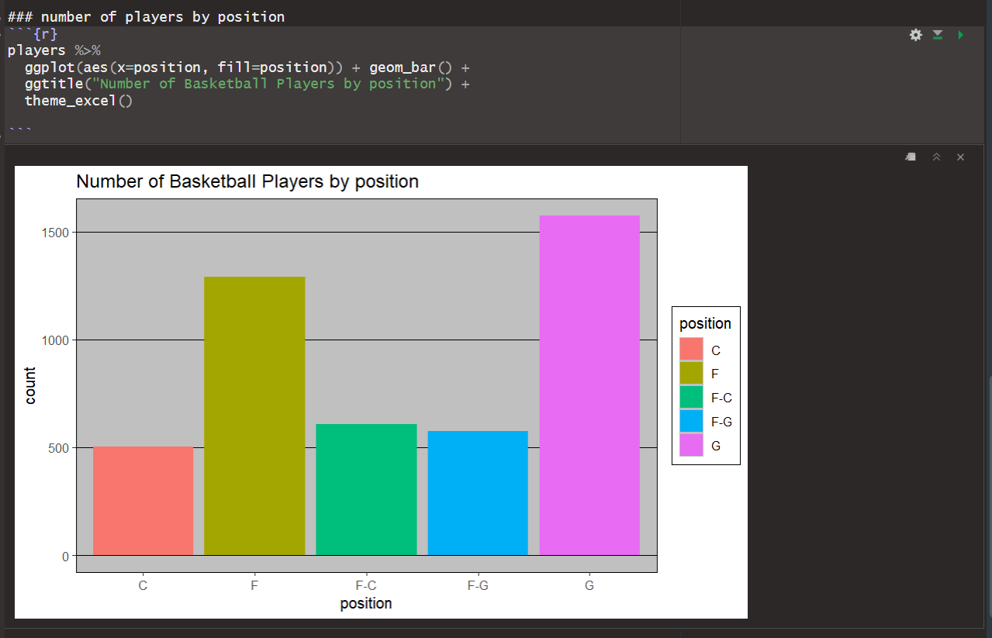
Represent the number of players in each position

Slide 5
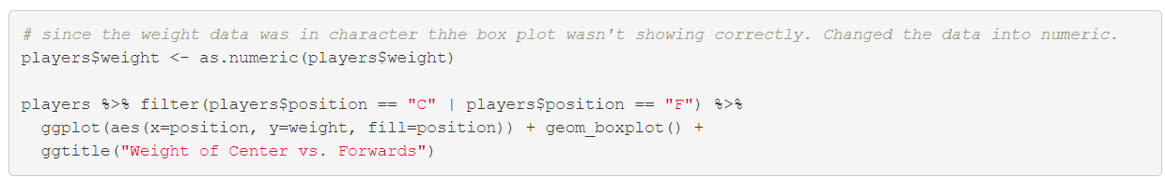
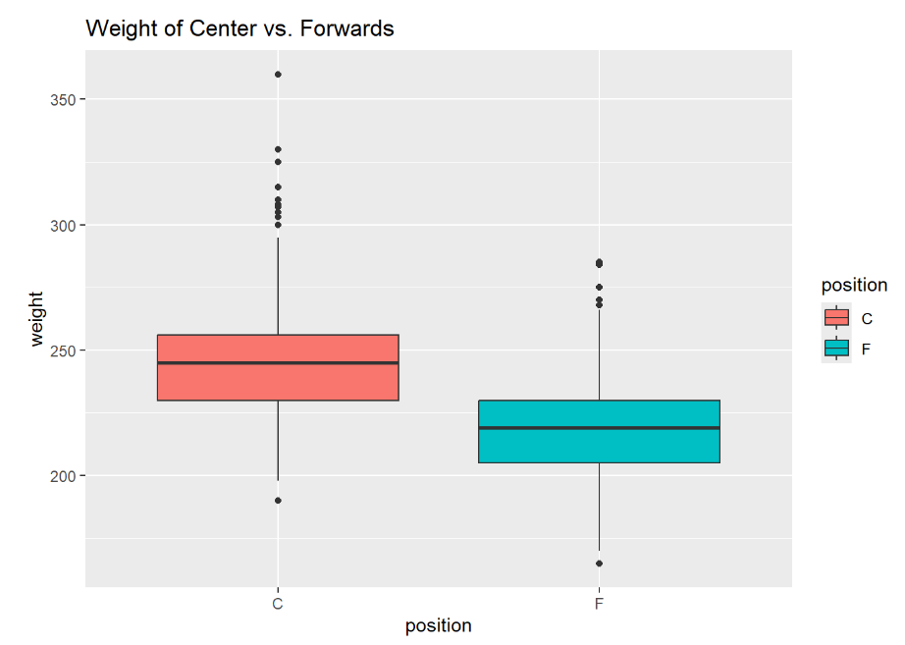
Weight of the center vs. forwards
According to the box plot, the distribution of the weight of center is greater than the distribution of weight of forwards.

Slide 6
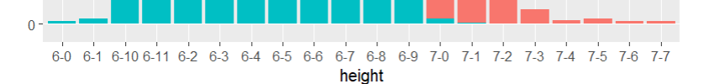
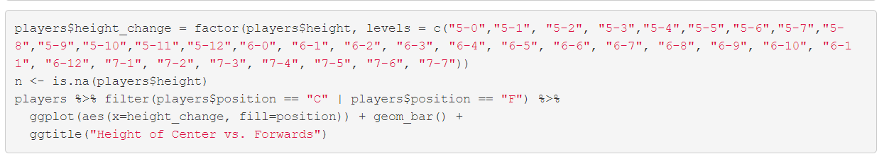
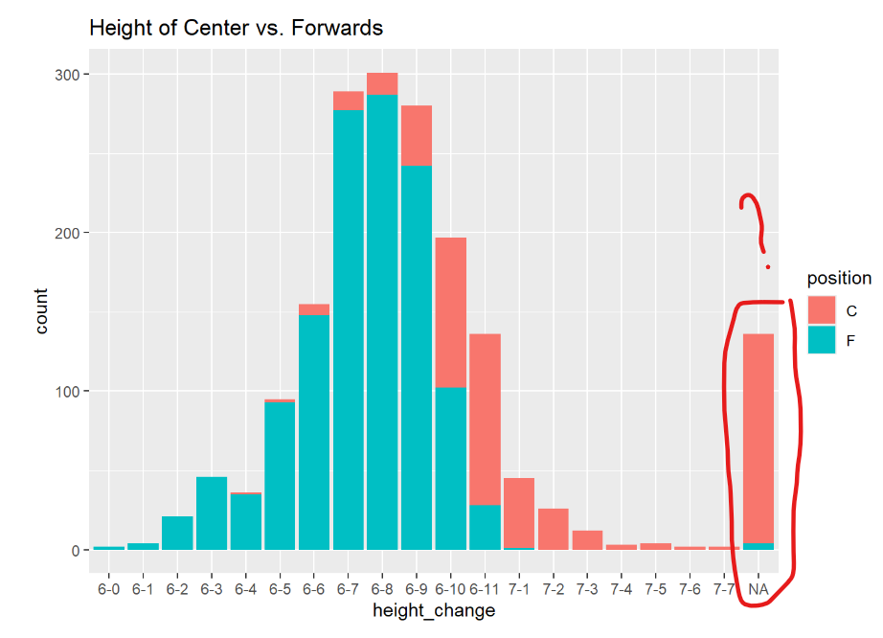
height of the center vs. forwards
<- Have to change the order of x-axis.
According to the bar chart, centers have a greater height distribution compared to forwards’.

Slide 7
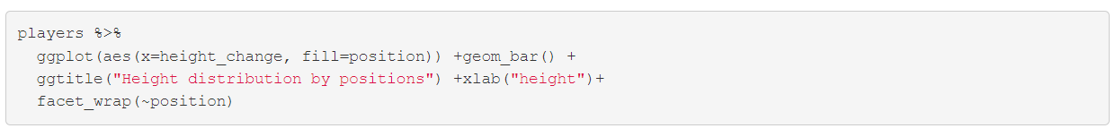
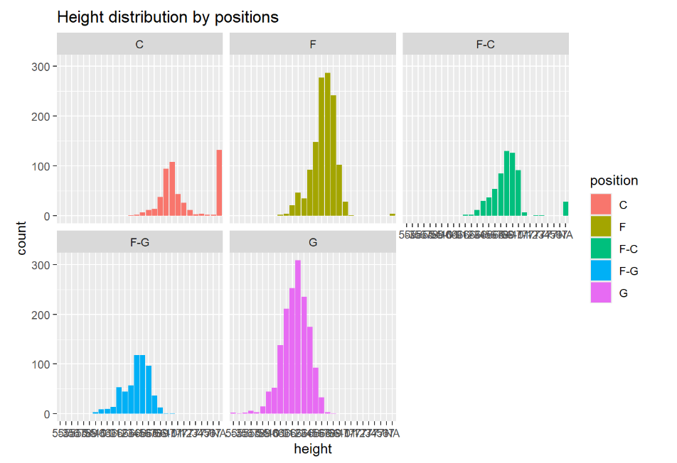
height difference between positions
Position of Center and Forwards-center tend to have higher height distribution.

Slide 8
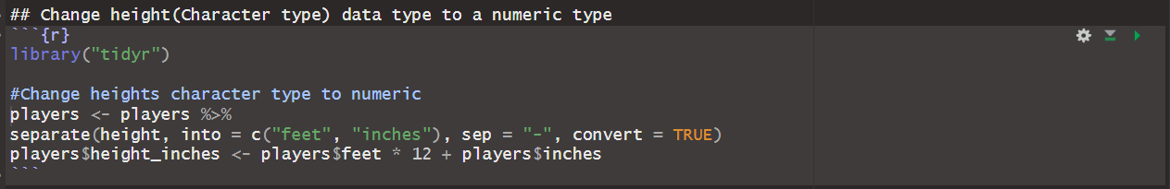
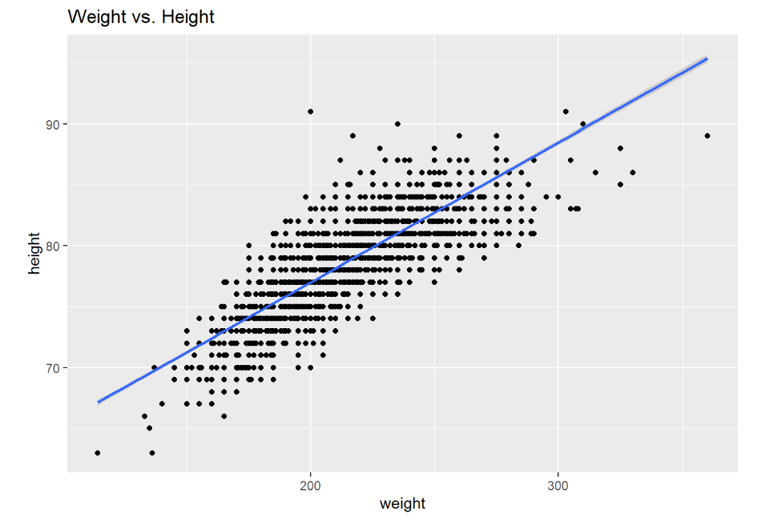
A relation between weight and height by position
Change data type of heights for better data presentation and finding relation.
According to the scatter plot, as height increases, weight increases.

Slide 9
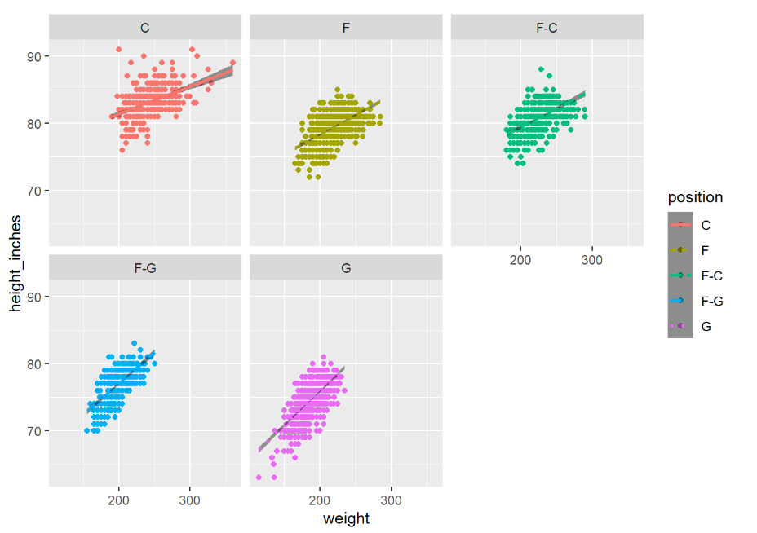
A relation between weight and height
According to the scatter plots and the linear graph in them, all the position shows a trend that weight increases as height increases. There isn’t enough evidence to say that the relation between weight and height is different by position.

Slide 10
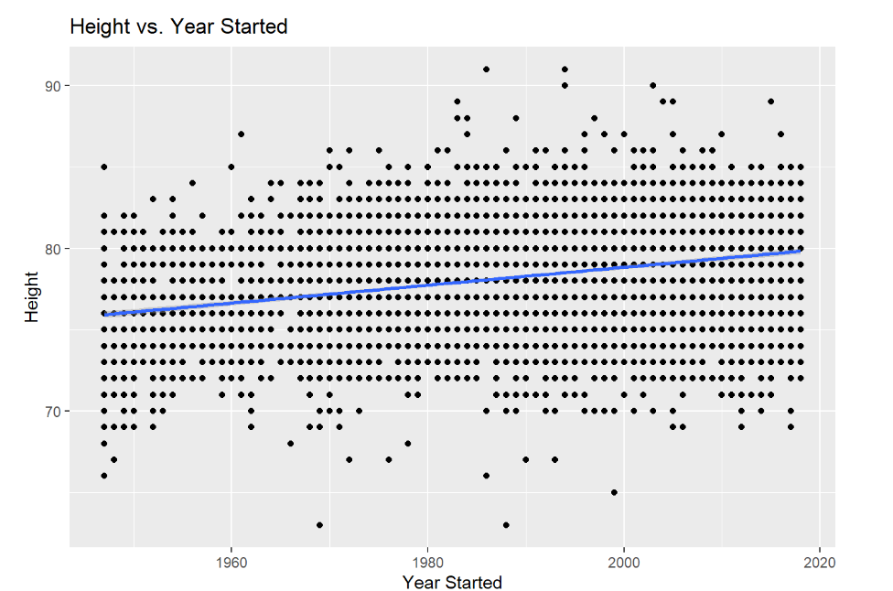
Height increase over the year
Although the slope of the linear line is low, there is an increase of eight as year increases.

Slide 11
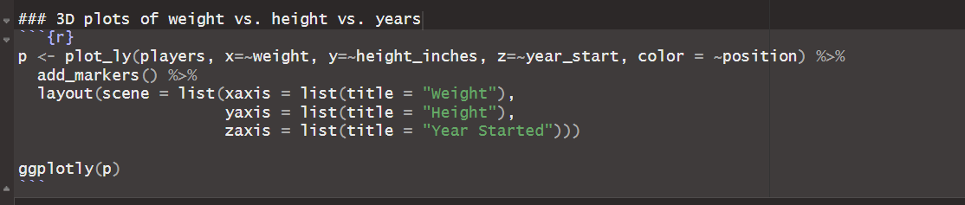
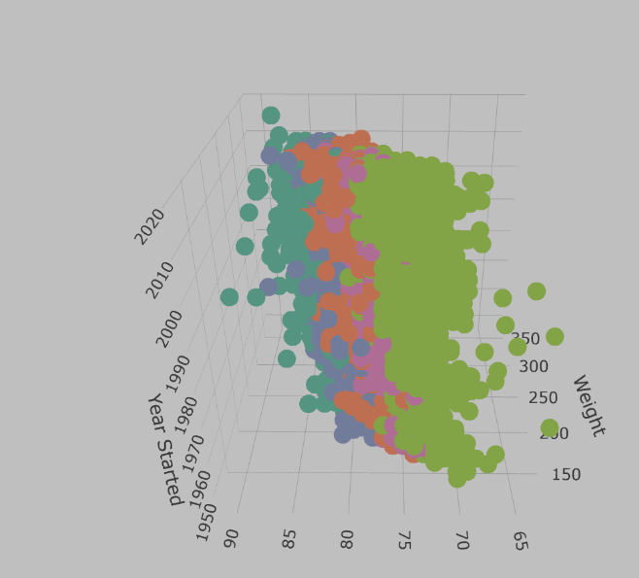
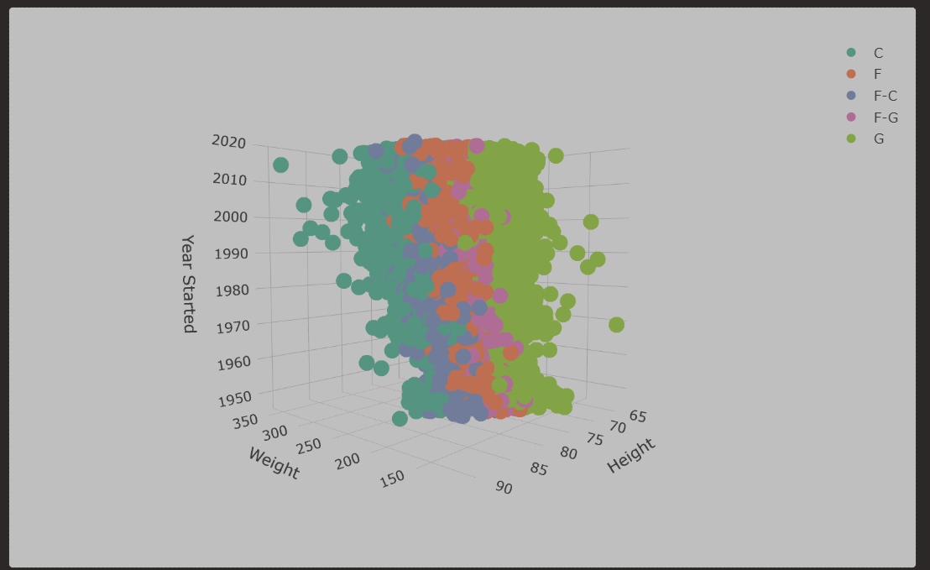
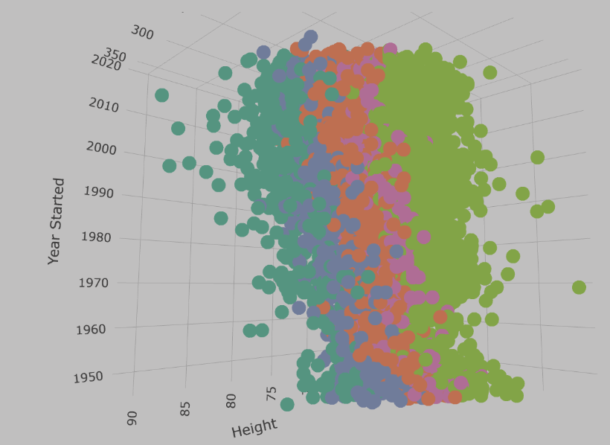
3D Height vs. weight vs. year started

Slide 12
50 Best plots
An effective chart is one that:
Conveys the right information without distorting facts.
Is simple but elegant. It should not force you to think much in order to get it
Aesthetics supports information rather than overshadow it.
Is not overloaded with information.

Slide 13
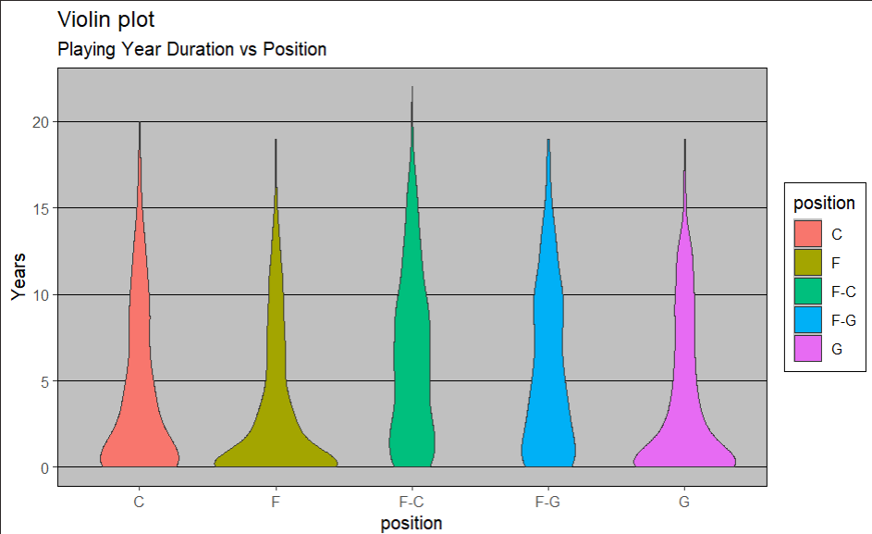
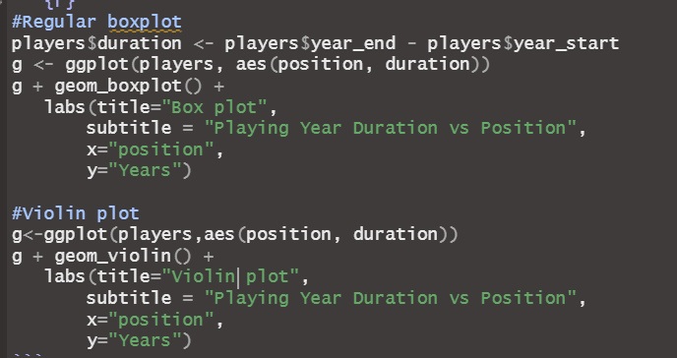
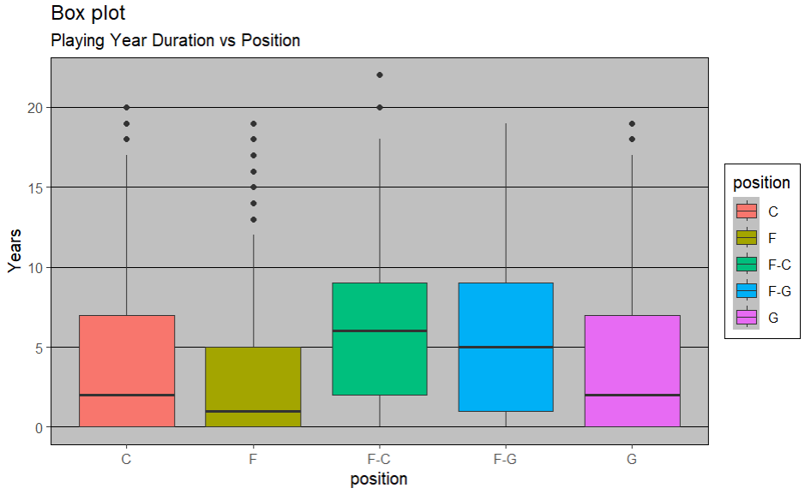
50 Best plots – Play years vs. position
According to the box plots, we can find that there’s a difference of play years duration by position since the median of forwards-guard and forwards-center is higher than rest of the position. Also, in the Violin plot, the bottom distribution of forwards-guard and forwards-center is narrower than the rest of the position.

Slide 14
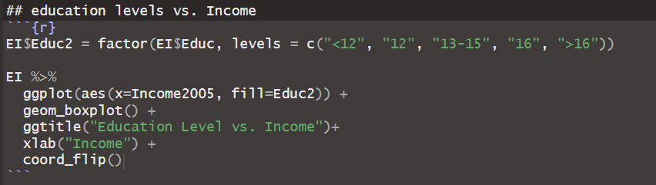
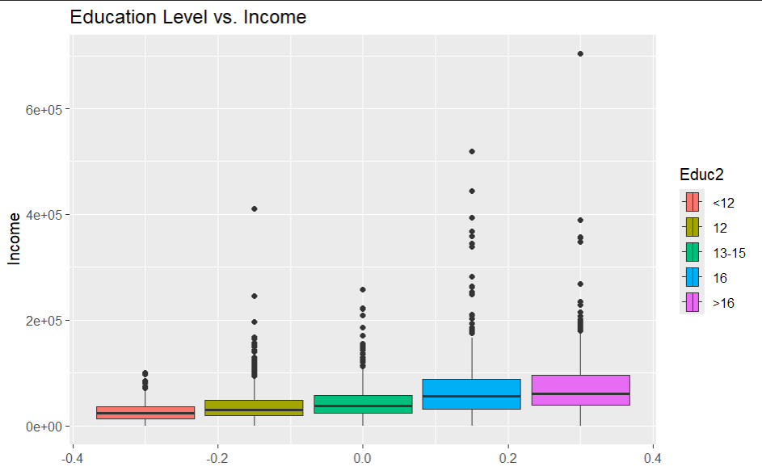
Education Level vs. Income
<- Reorder the education level columns for better comparison.
According to the box plots, we can find that the median is increasing as the education level increase.

Slide 15
Takeaway & question
Takeaways
Find the proper visualization chart type for each topics.
Learned which chart is the most efficient to display and communicate data for corresponding problems.
How to clean/mine data.
Learned how to recognize missing data and fill the data.
A way to replace data for consistent data format (F-G == G-F)
How to change character type to a numeric data type.
How to interpret data and communicate with visualization
How to research and experiment new functions.
Questions
When I tried to visualize the difference of height distribution of center position and forwards position, there were n/a data which I couldn’t find on the dataset. Where are they coming from and how can I fix it?
For visualizing Education level vs. Income, would there be better way to represent? How can I use mean to represent the data?

